Slide 1

NeRF - Neural Radiance Fields
Jovan Dmitrović / Jovan Bubonja

Slide 2
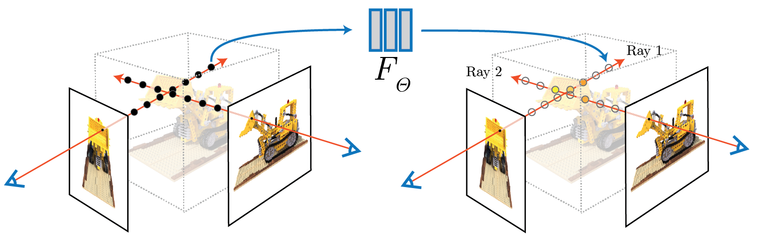
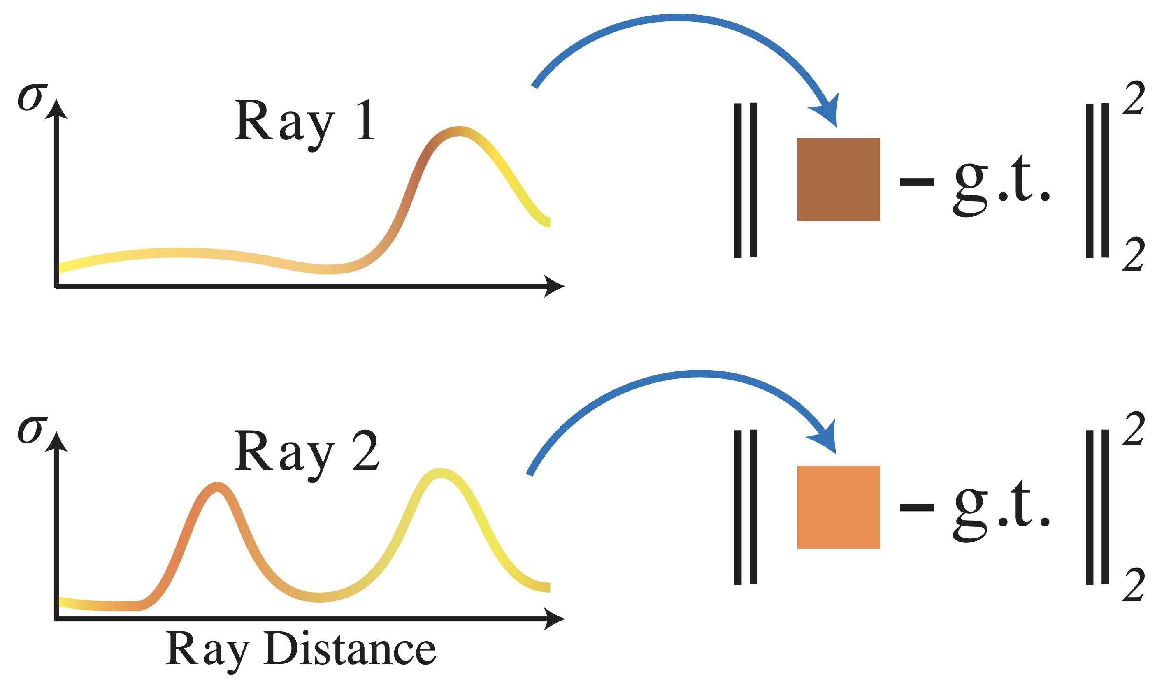
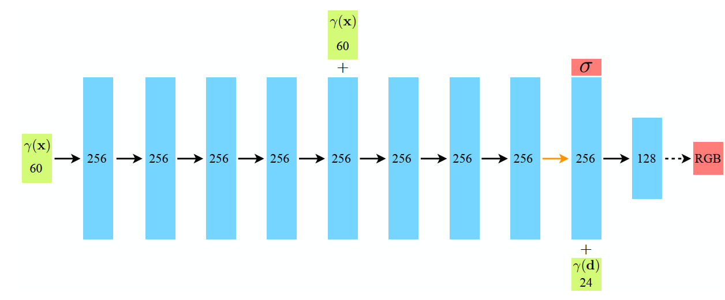
High level idea
NeRF: Representing Scenes as Neural Radiance Fields for View Synthesis
2

Slide 3
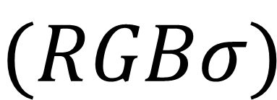
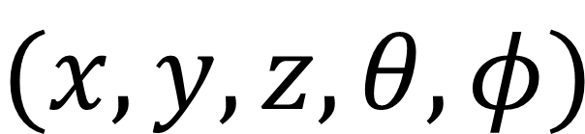
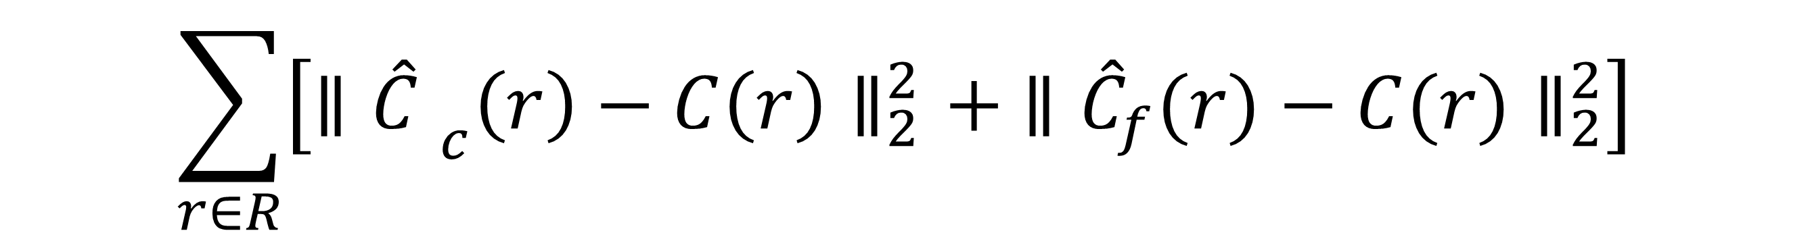
Problem setup
Model Classic MLP
Input
$$(x,y,z,θ,φ)$$
5D vector – spatial coordinates & viewing angles
Output
$$(RGBσ)$$
2D vector – color & occupancy
$$\sum_{r∈R}{\left[∥{\hat{C} }_{c}\left(r\right)−C\left(r\right)∥_{2}^{2}+ ∥{\hat{C}}_{f}(r)−C(r)∥_{2}^{2}\right]}$$
Loss
NeRF: Representing Scenes as Neural Radiance Fields for View Synthesis
1

Slide 4
Project plan
Plug and play
Get to know the code
Writing our own code
Try with other datasets
Create a custom scene
https://github.com/bmild/nerf
https://github.com/Harry-Zhi/semantic_nerf
https://github.com/Fyusion/LLFF
3

Slide 5
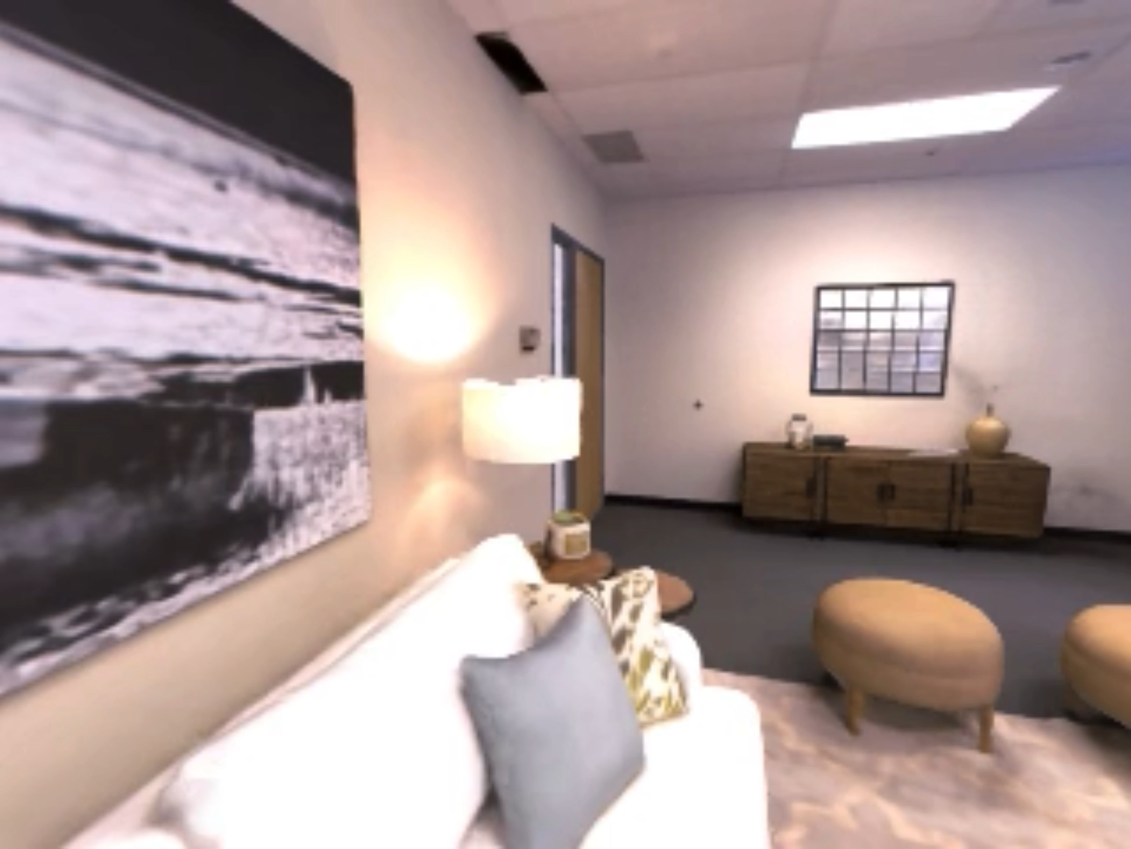
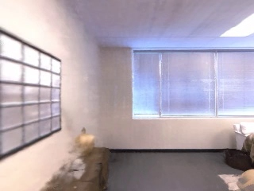
Plug and play on Replica dataset
Unseen poses from dataset
Custom unseen poses – 360⁰
https://github.com/facebookresearch/Replica-Dataset
4

Slide 6
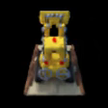
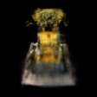
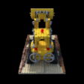
Trying on Lego dataset
Tiny NeRF
Our NeRF - Failed
Our NeRF - Success
https://github.com/bmild/nerf/blob/master/tiny_nerf.ipynb
5

Slide 7
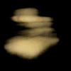
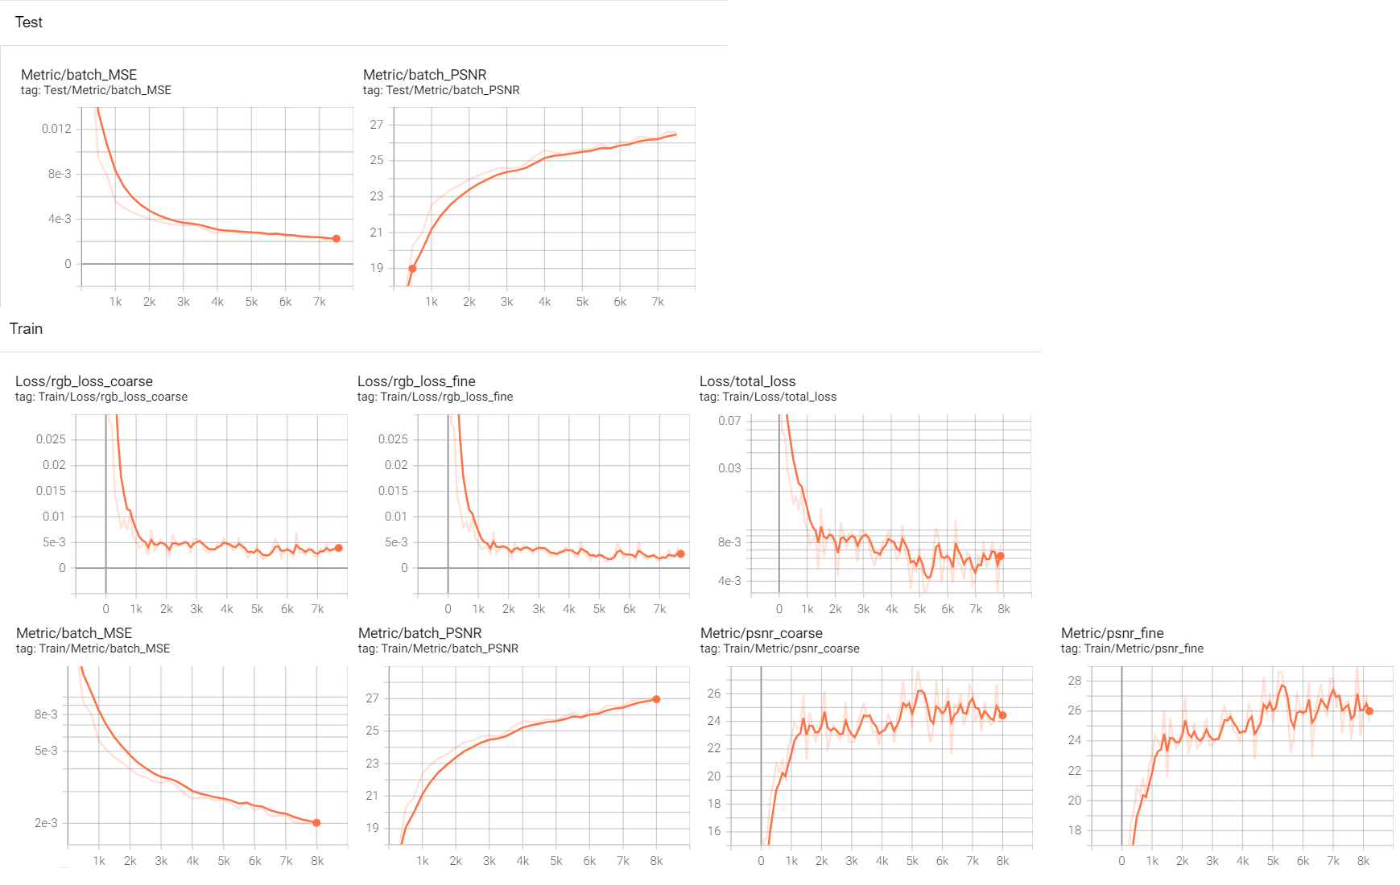
Rendering through iterations

Slide 8
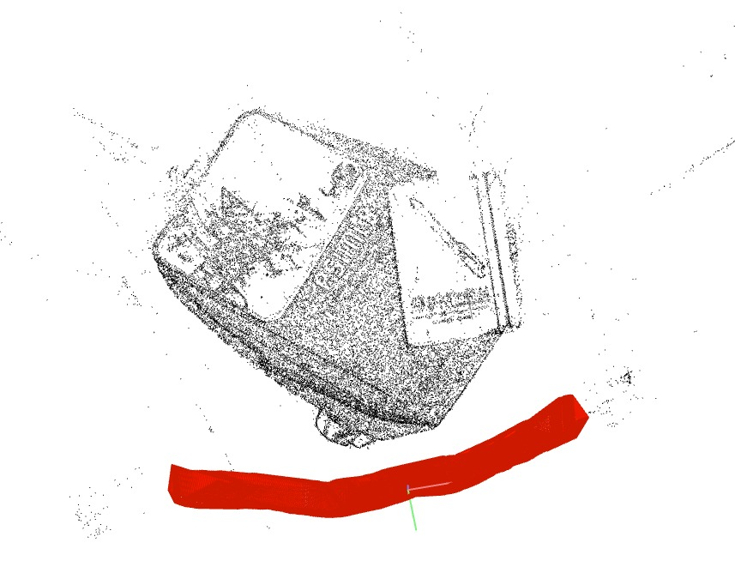
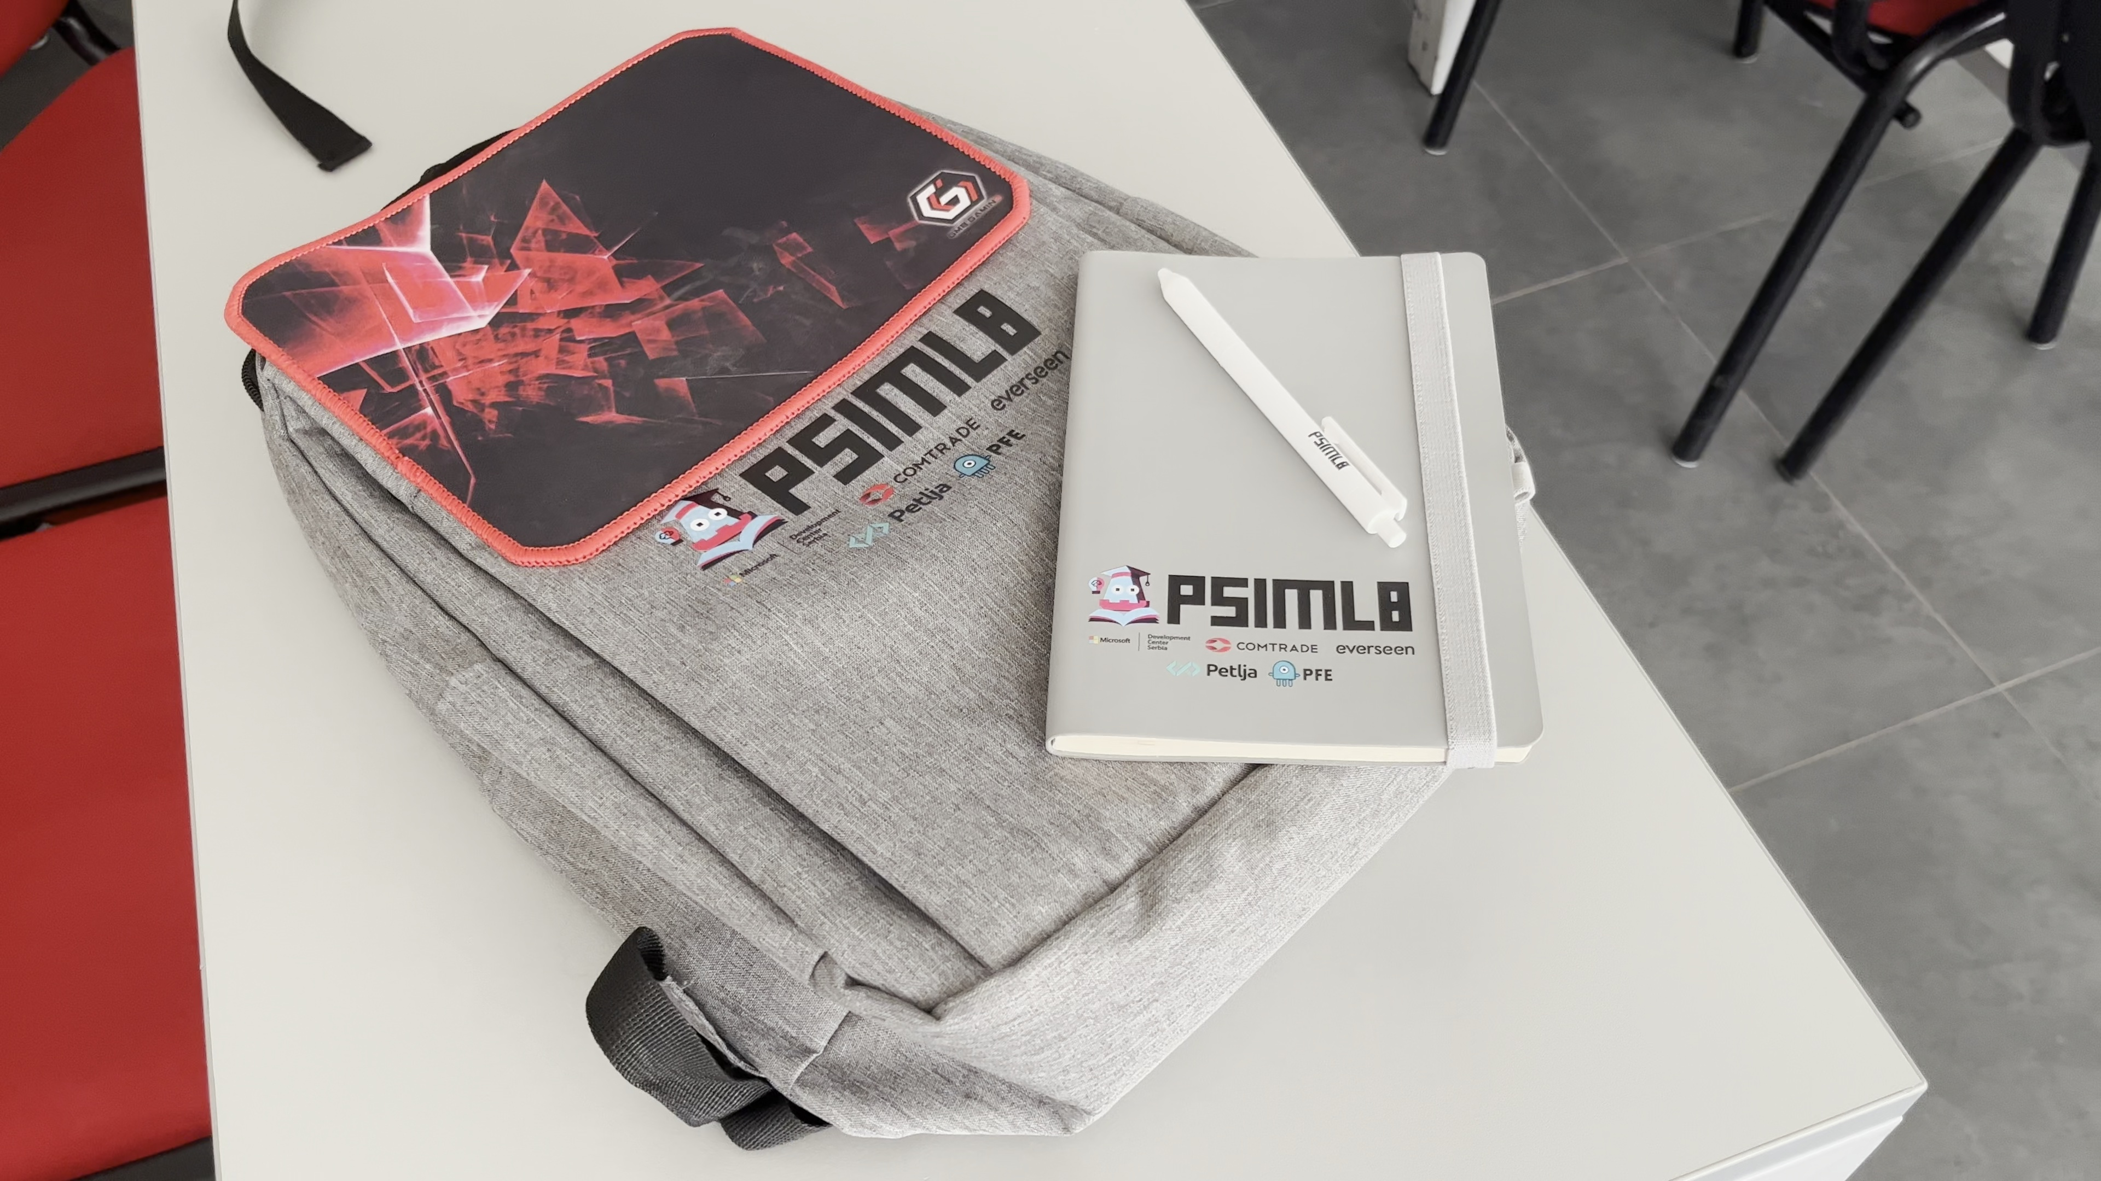
Custom PSI:ML8 scene
Scene setup
Using COLMAP to get image poses
6

Slide 9
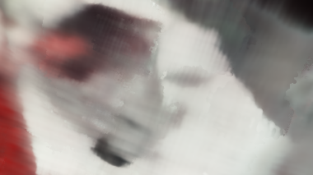
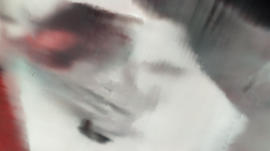
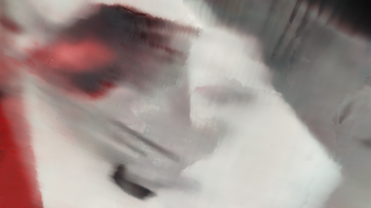
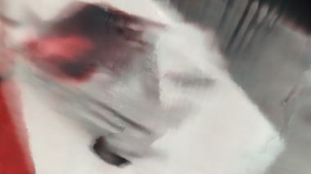
Custom PSI:ML8 scene
5k
10k
15k
20k
6

Slide 10

Questions ?

Slide 11
Thank you!

